Slide 1
Marketing Funnel
Nikhil Kumar

Slide 2
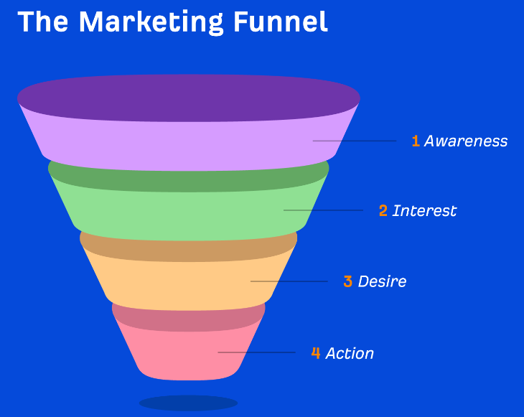
What is marketing funnel?

Slide 3
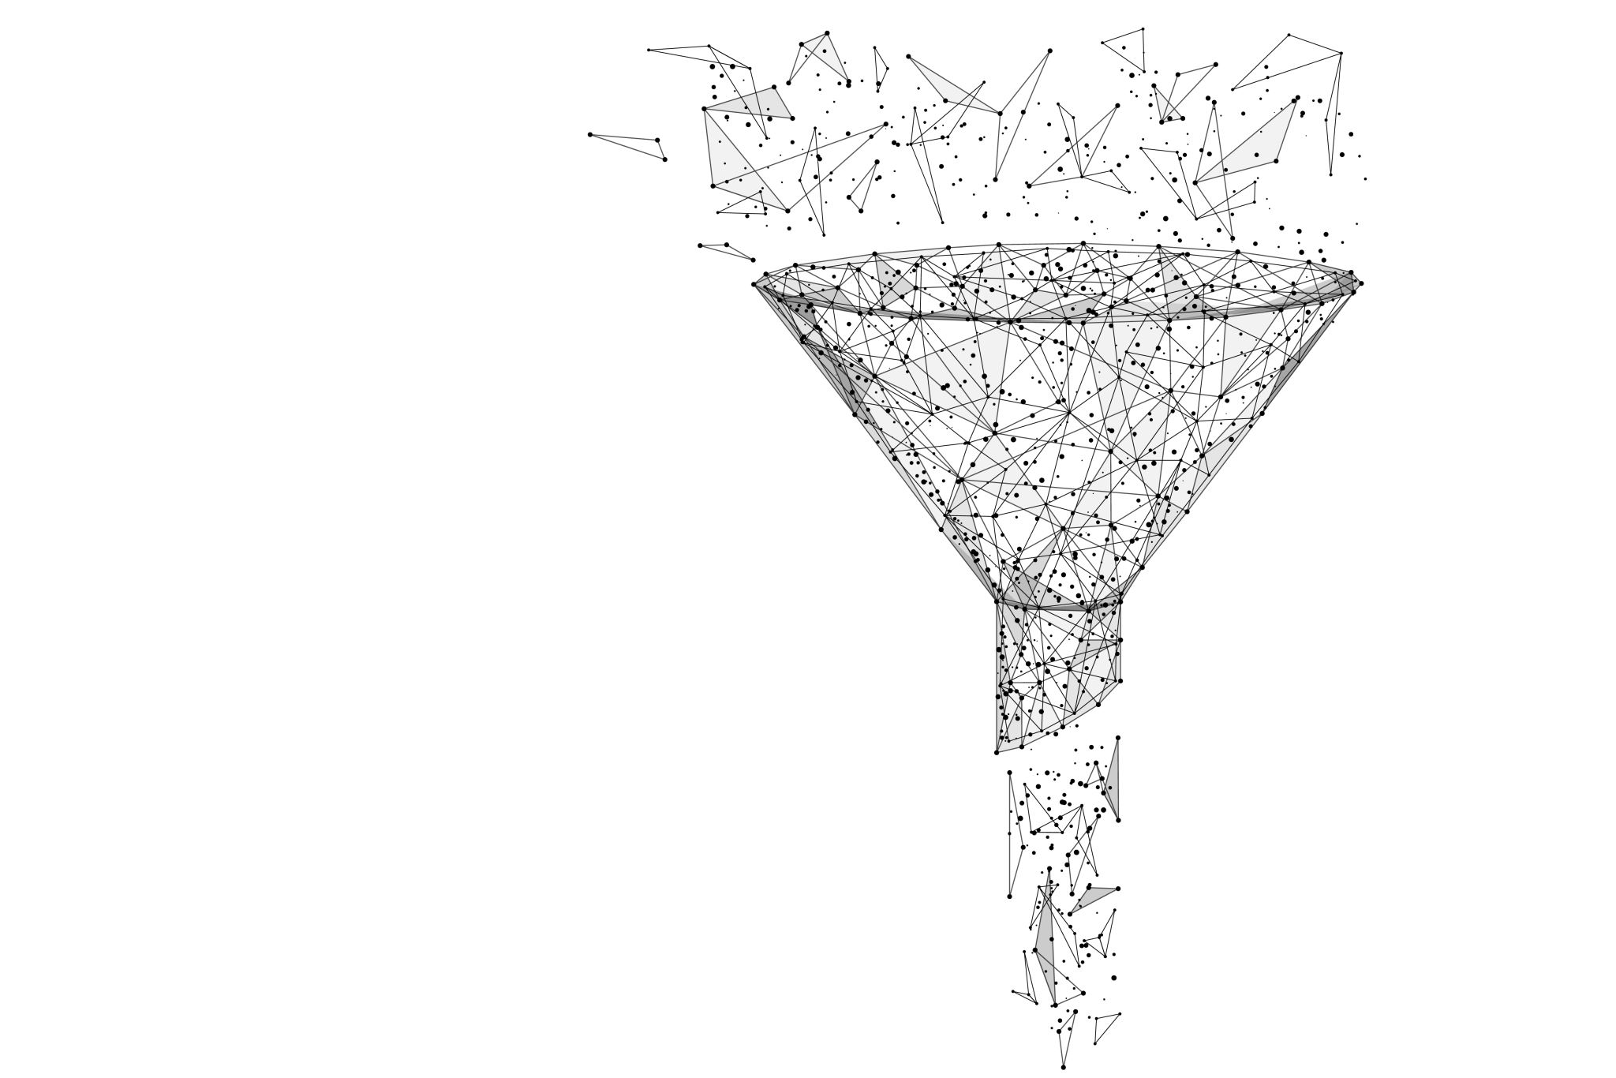
Stages of Marketing Funnel
Awareness – When someone becomes aware of your brand, product, or service.
Interest – When someone expresses interest in your product or service.
Desire – When someone evaluates your product or service. This stage is also known as “Consideration.”
Action – When someone becomes a customer. This stage is also known as “Conversion.”

Slide 4
Why Marketing Funnel matters?
Navigating the Non-linear: Unveiling the Crucial Role of the Marketing Funnel.
Unlocking Success: Harnessing the Power of the Marketing Funnel's Simplified Journey.
From Chaos to Clarity: Mastering Marketing Funnel Dynamics for Sustainable Growth.
Plug the Leaks, Secure the Success: How the Marketing Funnel Fixes Customer Journey Gaps

Slide 5
How to create a marketing funnel?
Top of the funnel (TOFU) – Building awareness about your product/ the problem you address.
Middle of the funnel (MOFU) – Teaching people how to choose the solution.
Bottom of the funnel (BOFU) – Explaining why your product is the best solution.

Slide 6
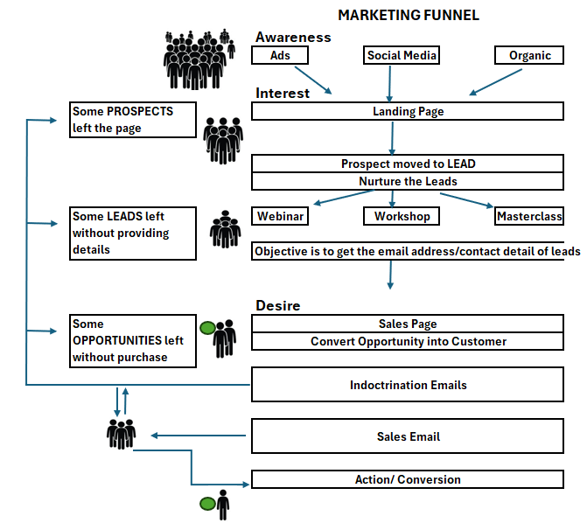
Marketing Funnel Strategy in reality

Slide 7
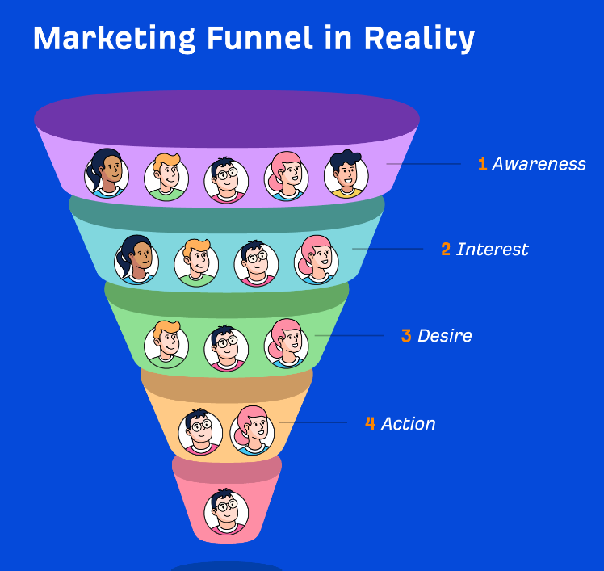
Marketing Strategy in reality

Slide 8
Thank you

